Slide 1
Prof. Anton Ovchinnikov
Prof. Spyros Zoumpoulis
DSB Classes 7-8, February 6, 2018
Advanced Classification. From .R to Notebooks. Dimensionality Reduction
Notes:
https://mbacourse.insead.edu/courses/DSC/SGP_P3_Data_Science_for_Business_OvchinnikovZoumpoulis_1830_July/pages/default.aspx

Slide 2
Structure of the course
SESSIONS 1-2 (AO): Data analytics process; from Excel to R
Tutorial 1: Getting comfortable with R
SESSIONS 3-4 (AO): Time Series Models
SESSIONS 5-6 (AO): Intro to classification, logistic regression and machine learning
Tutorial 2: Midterm R help / classification
SESSIONS 7-8 (SZ): Advanced Classification; From .R to Notebooks; Dimensionality reduction
SESSIONS 9-10 (SZ): Clustering and Segmentation
Tutorial 3: Q&A on R for three main modules
SESSIONS 11-12 (SZ): Catch-up and wrap-up; Guest speaker
“Tutorials 4,5”: Hands-on help on projects
SESSIONS 13-14 (AO+SZ): Project presentations

Slide 3
Plan for the day Learning objectives
Advanced classification: metrics and methods
Regularization. Advanced tree methods.
From .R scripts to Notebooks
New way/process for doing and communicating analytics with reproducible, publication-quality output
Derived attributes and dimensionality reduction
Generate (a small number of) new manageable/interpretable attributes that capture most of the information in the data

Slide 4
Overfitting & Regularization
What happened when in Assignment 2, you made a rpart CART tree with very small cp?
Fundamental tradeoff of learning with data
Models that are too simple are not accurate on the training set, and also don’t generalize well on the test set
Models that are too accurate on training set are too complex, and therefore don’t generalize well on the test set

Slide 5
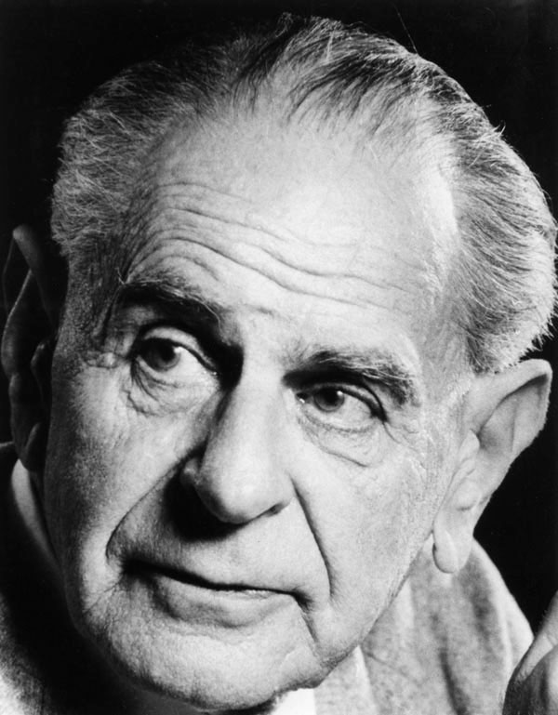

Overfitting & Regularization
Karl Popper
Albert Einstein

Slide 6
Overfitting & Regularization
Need to fine-tune the model so that is strikes a good balance between accuracy and simplicity
Cross-validation does this fine-tuning
Break the data into training data, validation data, test data
Train model using training data
Test on validation data to fine-tune parameters, and iterate
“When happy,” test (once) on test data to simulate how model would do in the real world

Slide 7
Overfitting & Regularization
Regularization: set of techniques to reduce overfitting
For logistic regression:
measures fit
controls trade off between maximizing fit and minimizing complexity
measures complexity
α= 1: penalize sum of absolute values of coefficients. Lasso regression
α=0: penalize sum of squares of coefficients. Ridge regression
Package: glmnet
cv.out <- cv.glmnet(as.matrix(estimation_data[,independent_variables]),estimation_data[,dependent_variable],alpha=1,
family="binomial" )
#family= "binomial" => logistic regression
#alpha=1: Lasso
lambda <- cv.out$lambda.1se #choose value of λ
log_reg_coefficients <- as.matrix(coef(cv.out,s=lambda)) #extract the estimated coefficients

Slide 8
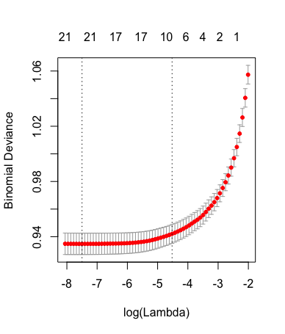
Overfitting & Regularization
> plot(cv.out)
λ that minimizes mean cross-validated error:
> log(cv.out$lambda.min)
[1] -7.498859
largestλ s.t. error is within 1 standard error of the minimum:
> log(cv.out$lambda.1se)
[1] -4.52178
Emphasizes simplicity (even) more

Slide 9
Important classification metric: Profit Curve
Measure business profit if we only select the top cases in terms of the probability of “response”
For this, we need to define values and costs of correct classifications and misclassifications
 | Predicted: default | Predicted: no default
Actual: default | $0 | -$100000
Actual: no default | $0 | $20000
Profit = # of 1’s correctly predicted * value of capturing a 1
+# of 0’s correctly predicted * value of capturing a 0
+# of 1’s incorrectly predicted as 0 * cost of missing a 1
+# of 0’s incorrectly predicted as 1 * cost of missing a 0

Slide 10
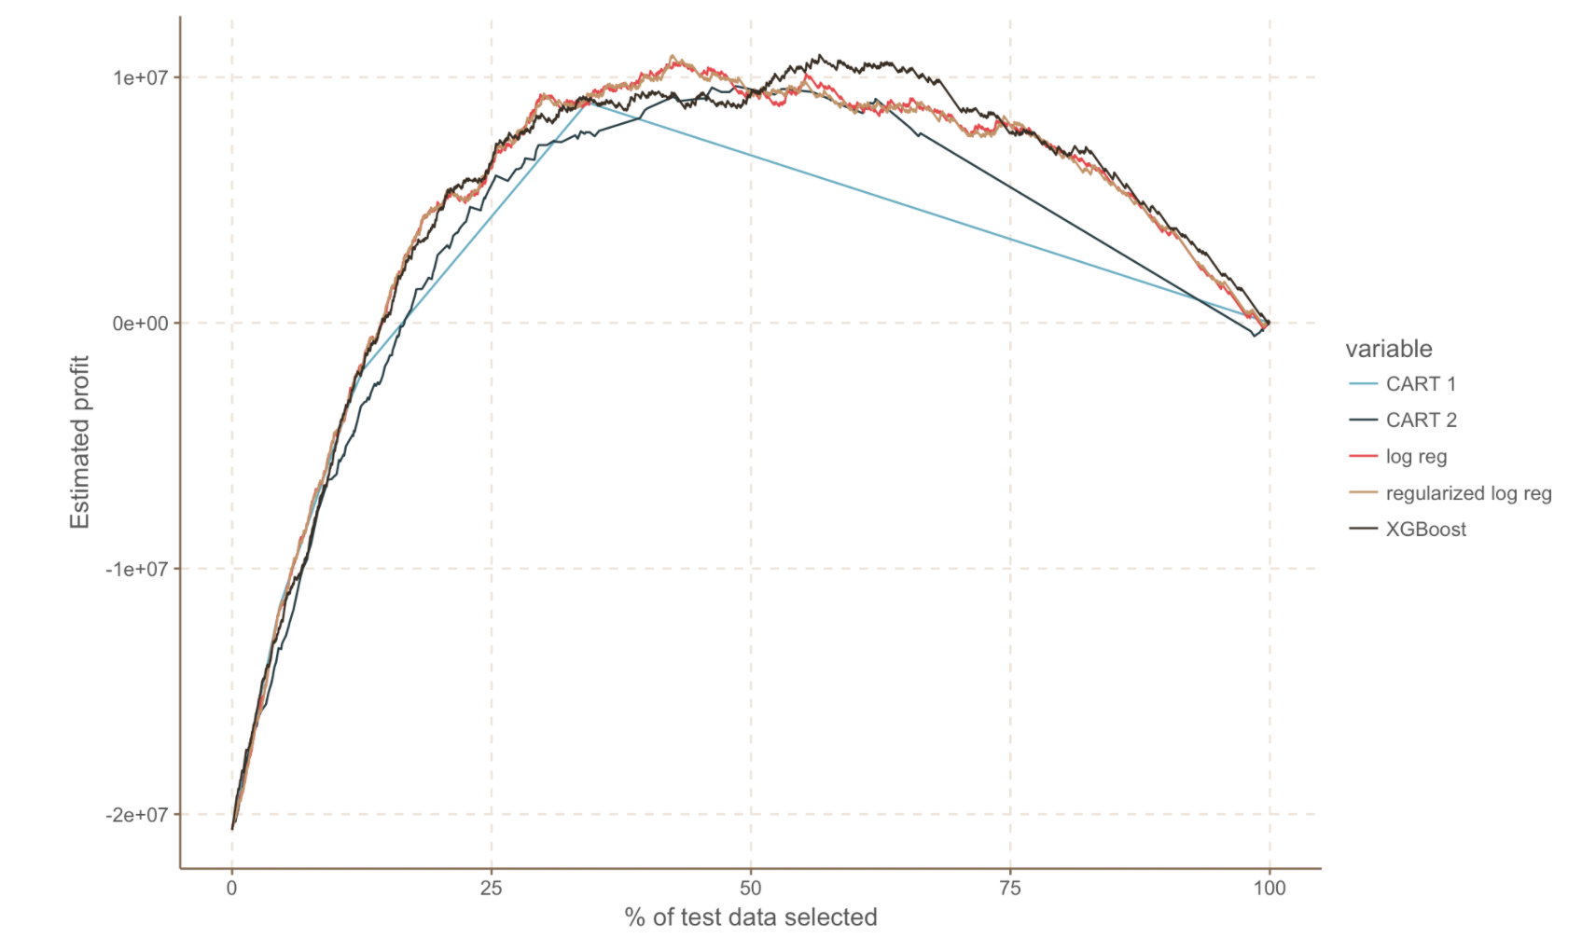
Important classification metric: Profit Curve
Given a classifier, rank instances in the test data from highest predicted probability of belonging to class 1 (= default) to lowest
Can put the cutoff for giving vs. not giving credit at any rank
As I move the cutoff, calculate the corresponding profit…

Slide 11
Feature Engineering
Your data may have more information than what is contained in your existing variables
Spend lots of time thinking of ways to combine your variables into new ones!
“Engineering” good features may be more important than using a better method
Requires contextual knowledge of the business
Can not be outsourced
Can not be automated

Slide 12
Feature Engineering
Example for credit card default case:
tmpx = t(apply(ProjectData[,7:12], 1,
function(r) matrix(c(sum(r==-2), sum(r==-1), sum(r==0),sum(r > 0)), nrow=1)))
#apply: apply the function to an array of values
# argument “1”: apply the function over rows
ProjectData = cbind(ProjectData[,2:5], #cbind: combine a set of columns
tmpx,
apply(ProjectData[,13:18], 1, function(r) median(r[!is.na(r)])),
apply(ProjectData[,19:24]/ProjectData[,13:18], 1, function(r)
ifelse(sum(!is.na(r) & !is.infinite(r)), mean(r[!is.na(r) & !is.infinite(r)]),0)),
ProjectData[,25])
dependent_variable = 11
independent_variables = c(1:10) # use all the new attributes

Slide 13
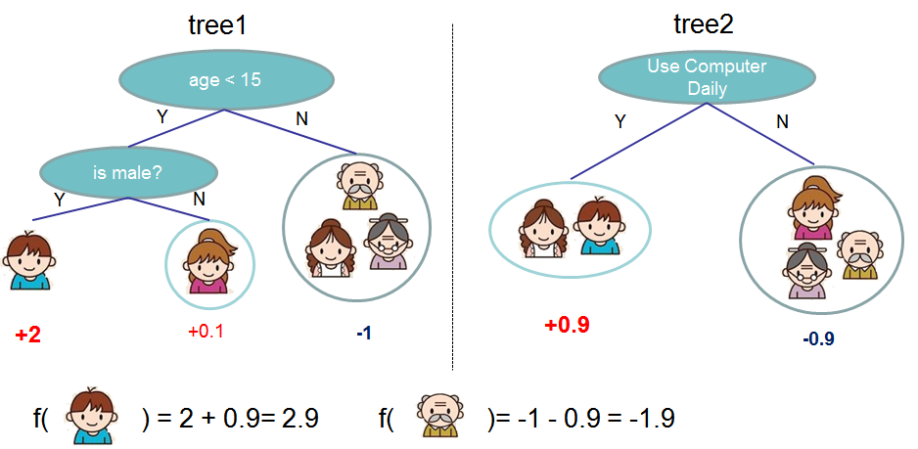
Tree Ensemble Methods
Main idea: put a set of CARTs together, output a combination (e.g., mode, mean) of the respective outputs the CARTs
Does someone like computer games?
Source: http://xgboost.readthedocs.io/en/latest/model.html#

Slide 14
Tree Ensemble Methods
Both random forests and boosted trees generate multiple random samples from the training set (with replacement), and train a different CART for each sample of the data. This is called bagging.
Random Forests
The samples are completely random. No adaptiveness.
Use fully grown CARTs (each with low bias, high variance). Reduce variance by bagging together many uncorrelated trees.
Final prediction is the simple average
Boosted trees
Based on weak learners (each with high bias, low variance)
But adaptive: instances that had been modeled poorly by the overall system before have larger probability of being picked now → higher weight
Final prediction is a weighted average

Slide 15
Tree Ensemble Methods
Random Forests
Package: randomForest
model_forest <- randomForest(x=estimation_data[,independent_variables],
y=estimation_data[,dependent_variable],
importance=TRUE, proximity=TRUE, type="classification”)
Boosted trees
Package: xgboost
model_xgboost <- xgboost(data = as.matrix(estimation_data[,independent_variables]),
label = estimation_data[,dependent_variable],
eta = 0.3, max_depth = 10, nrounds=10, objective = "binary:logistic", verbose = 0)
#objective= "binary:logistic" => logistic regression for classification
#eta: step size of each boosting step. max.depth: maximum depth of tree.
#nrounds: the max number of iterations
How to then retrieve predicted probabilities (and therefore also classes)?
validation_Probability_class1<- predict(model,newdata=as.matrix(validation_data[,independent_variables]), type= "prob" )

Slide 16
(A) Process for Classification
Split the data
Set up the dependent variable
Simple Analysis
Classification and Interpretation
Validation accuracy
Use various classification metrics you know
Test accuracy

Slide 17
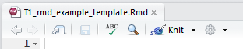
From R to Notebooks
You traditional approach for “using” analytics has been two-step:
“do” analytics (e.g., plot a graph in Excel)
“communicate” analytics (e.g., copy-paste the graph into a PowerPoint presentation / Word file report, etc.)
With coding (and R) there is a better way: “notebooks”
“knit” the R markdown (*.Rmd) file
This will create a *.html report (a webpage) with the analysis outputs, graphs, text. Can also create a PDF report
Main advantage of this approach: ALL IN ONE PLACE
When the new data is available (e.g., next quarter’s sales numbers come in), creating an updated report will take you… 1 click
Along with sharing tools (GitHub): reusable, replicable, easy to share, all-in-one-place way of doing analytics and communicating them with publication-quality output

Slide 18
Derived Attributes and Dimensionality Reduction
What is dimensionality reduction?
Generate (a small number of) new attributes that are (linear) combinations of the original ones, and capture most of the information in the original data
Often used as the first step in data analytics
Why do dimensionality reduction?
Computational and statistical reasons: with thousands of features, very expensive and hard to estimate a good model
Managerial reason: the new attributes are interpretable and actionable
The key idea of dimensionality reduction
Transform the original variables into a smaller set of factors
Understand and interpret the factors
Use the factors for subsequent analysis

Slide 19
Dimensionality Reduction: Key Questions
How many factors do we need?
How would you name the factors? What do they mean?
How interpretable and actionable are the factors we found?

Slide 20
(A) Process for Dimensionality Reduction
Confirm the data is metric
Scale the data
Check correlations
Choose number of factors
Interpret the factors
Save factor scores

Slide 21
Applying Dimensionality Reduction: Evaluation of MBA Applications
Variables available:
GPA
GMAT score
Scholarships, fellowships won
Evidence of communications skills
Prior job experience
Organizational experience
Other extra curricular achievements
Which variables are correlated? What do these groups of variables capture?

Slide 22
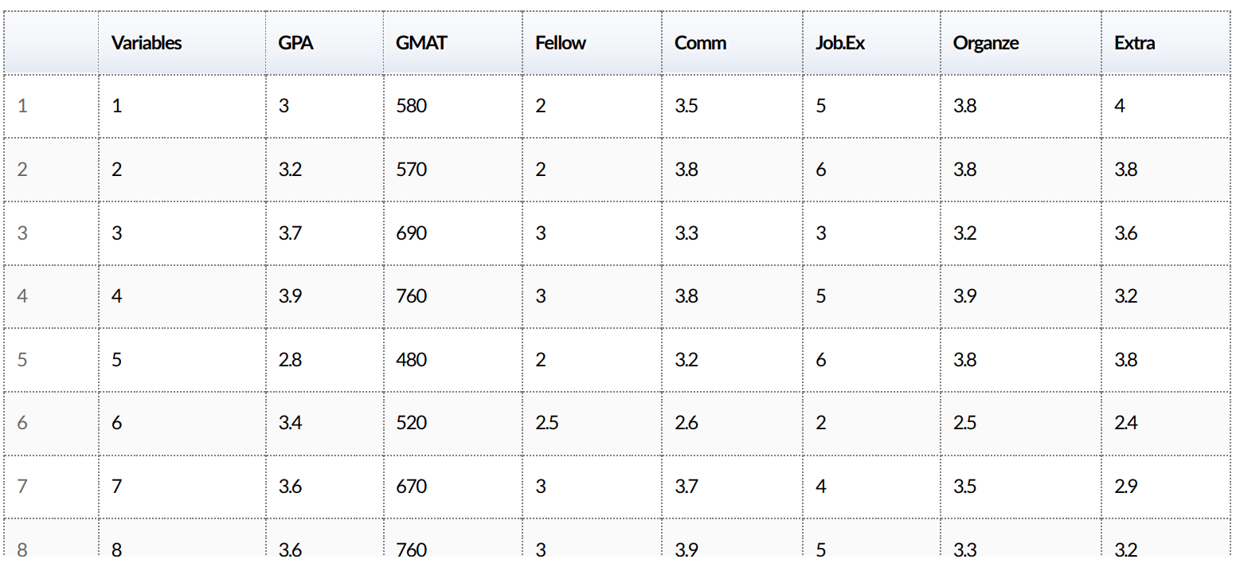
Step 1: Confirm data is metric

Slide 23
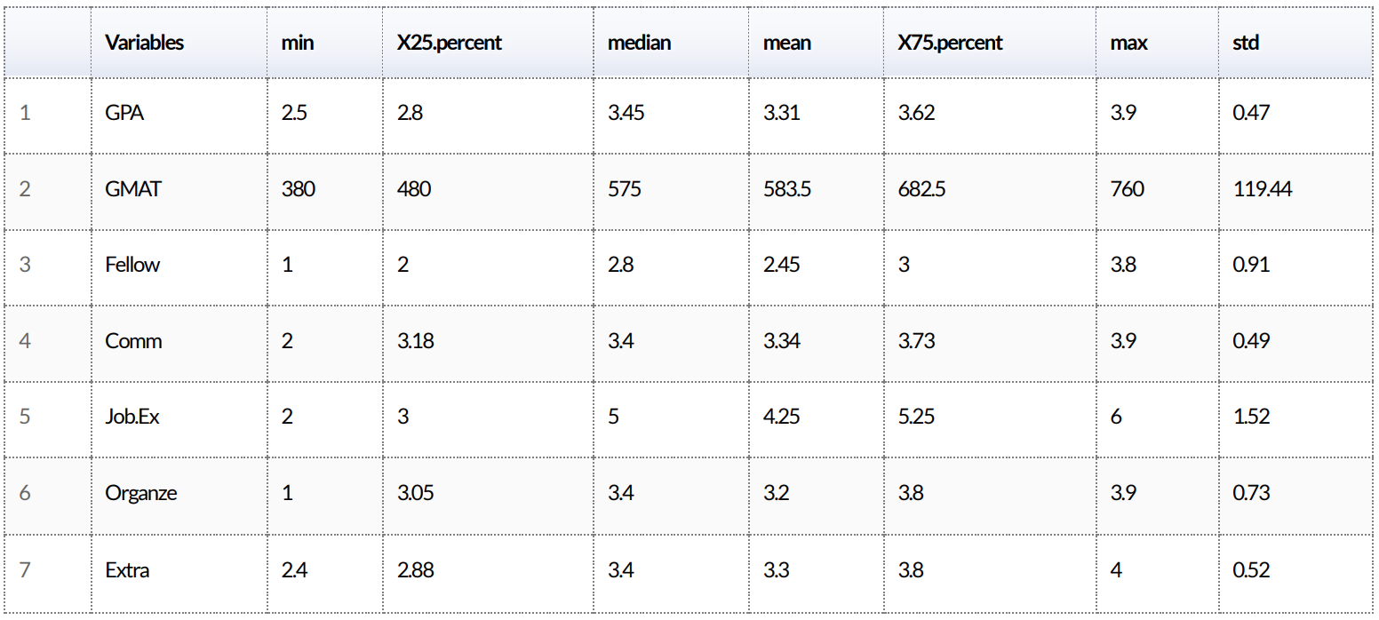
Step 2: Scale the data
Before standardization

Slide 24
Step 2: Scale the data
Standardization….
ProjectDatafactor_scaled=apply(ProjectDataFactor,2, function(r) { #”2” applies the function over columns
if (sd(r)!=0) {
res=(r-mean(r))/sd(r)
} else {
res=0*r; res
}
})

Slide 25
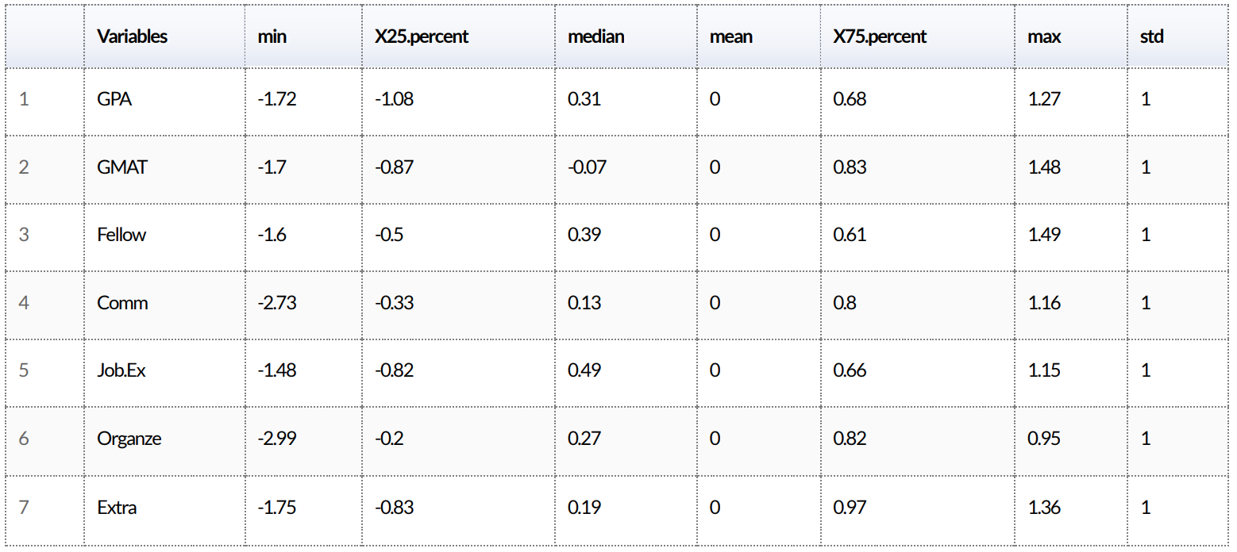
Step 2: Scale the data
After standardization

Slide 26
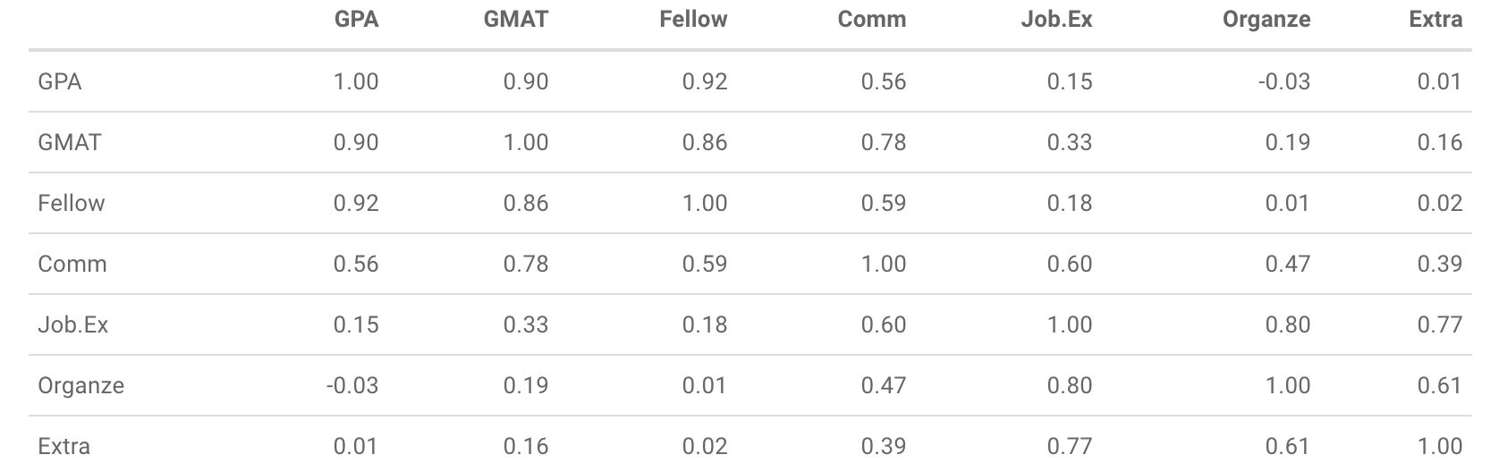
Step 3: Check correlations

Slide 27
Step 3: Check correlations

Slide 28
Step 4: Choose the number of factors
We use Principal Component Analysis
Package: psych
UnRotated_Results<-principal(ProjectDataFactor, nfactors=ncol(ProjectDataFactor), rotate="none”, score=TRUE)
Factors are linear combinations of the original raw attributes…
…so that they capture as much of the variability in the data as possible
Factors are uncorrelated, and as many as the variables
Each factor has an associated “eigenvalue” – which corresponds to the amount of variance captured by that factor
First factor has the highest eigenvalue and explains most of the variance, then the second, …, and so on

Slide 29
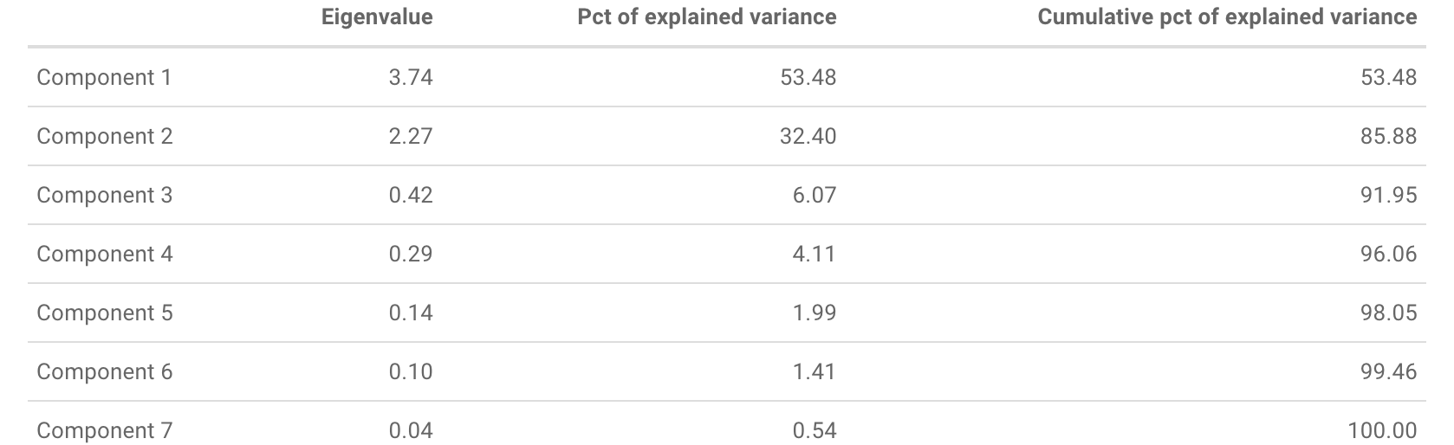
Step 4: Choose the number of factors
Package: FactoMineR
Variance_Explained_Table_results<-PCA(ProjectDataFactor, graph=FALSE)
Variance_Explained_Table<-Variance_Explained_Table_results$eig
> Variance_Explained_Table[1,1]/sum(Variance_Explained_Table[,1]) ??
[1] 0.5347987

Slide 30
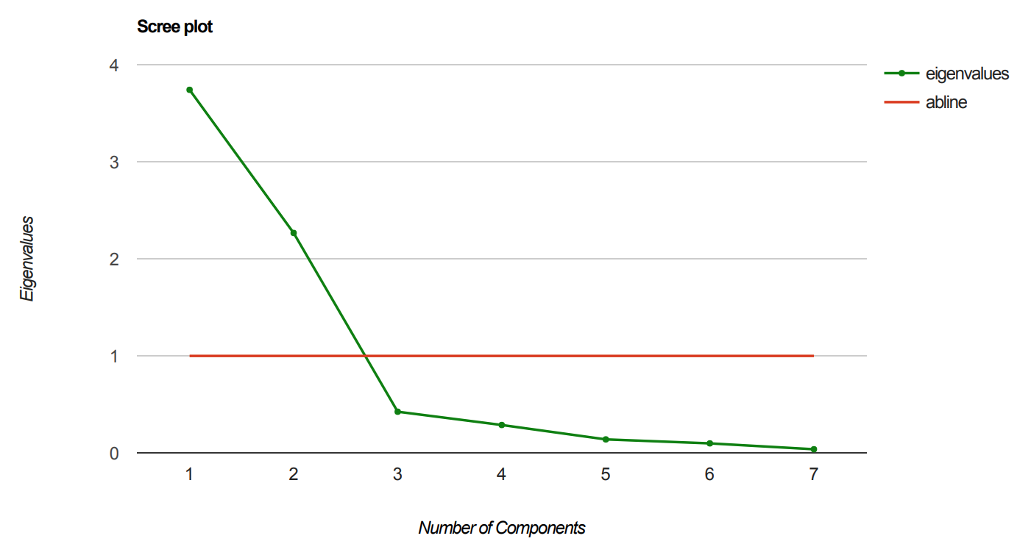
Step 4: Choose the number of factors
We want to capture as much of the variance as possible, with as few factors as possible. How to choose the factors? Three criteria to use:
Select all factors with eigenvalue > 1
Select factors with highest eigenvalues up to exceeding a threshold (e.g. 65%) in cumulative % of explained variance
Select factors up to the “elbow” of the scree plot

Slide 31
Step 5: Interpret the factors
To interpret the factors, we want them to use only a few, non-overlapping original attributes
Factor “rotations” transform the estimated factors into new ones that satisfy that, while capturing the same information

Slide 32
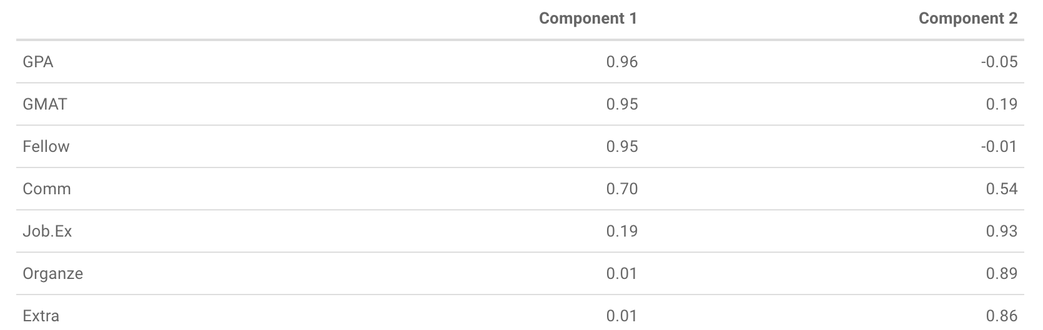
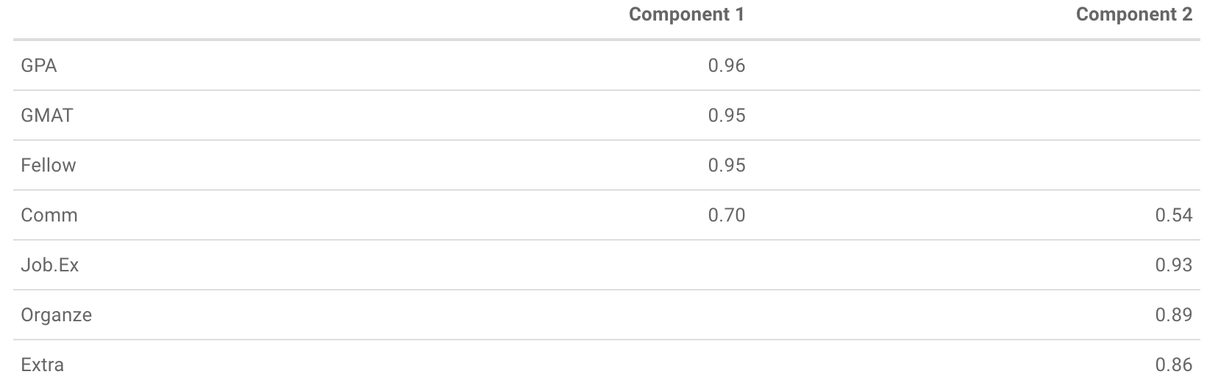
Step 5: Interpret the factors
Package: psych
Rotated_Results<-principal(ProjectDataFactor, nfactors=max(factors_selected),
rotate="varimax”, score=TRUE)
Rotated_Factors<-round(Rotated_Results$loadings,2)
To better visualize and interpret: suppress loadings with small values
Rotated_Factors_thres <- Rotated_Factors
Rotated_Factors_thres[abs(Rotated_Factors_thres) < MIN_VALUE]<-NA

Slide 33
Step 5: Interpret the factors
What factor loads “look good"? Three technical quality criteria:
For each factor (column) only a few loadings are large (in absolute value)
For each raw attribute (row) only a few loadings are large (in absolute value)
Any pair of factors (columns) should have different "patterns" of loading

Slide 34
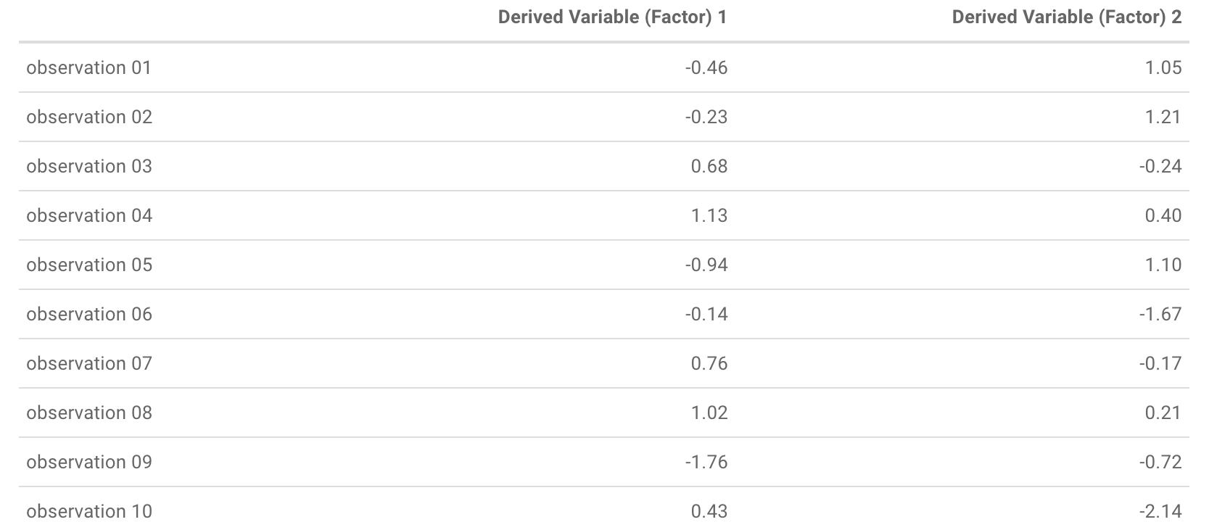
Step 6: Save factor scores
Replace the original data with a new dataset where each observation (row) is described using the derived factors
For each row, estimate the factor scores: how the observation “scores” for each of the selected factors
Package: psych
NEW_ProjectData <- round(Rotated_Results$scores[,1:factors_selected],2)

Slide 35
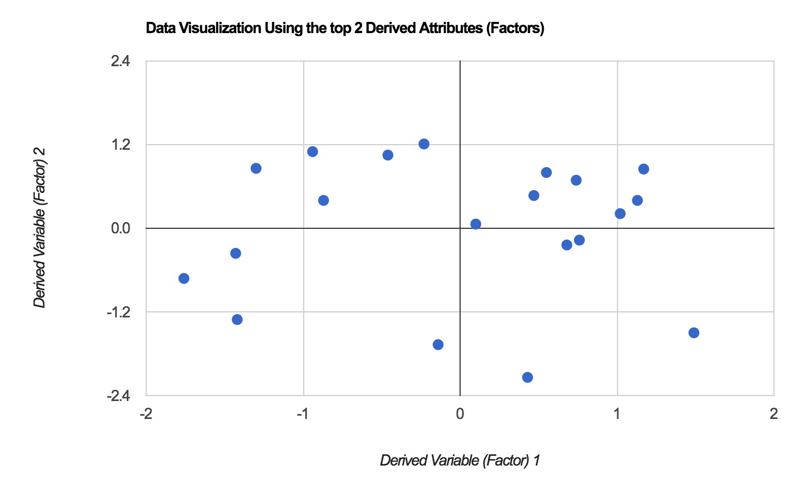
Step 6: Save factor scores
Then continue the analysis (e.g., make decision, or do clustering, etc.) with the new attributes

Slide 36
Summary of Sessions 7-8
Advanced classification:
Regularization, profit curve, more methods (regularized regression, XGBoost, …), a process for classification
Feature engineering
From R scripts to Notebooks
New way/process for doing and communicating analytics with reproducible, publication-quality output
Derived attributes and dimensionality reduction
A process for dimensionality reduction using Principal Component Analysis
Then continue analysis on the new attributes (next time: clustering and segmentation)

Slide 37
Next…
Sessions 9-10: [Fri, Feb 9 Amphi 307]
Cluster Analysis and Segmentation
BOR – work on the market segmentation process for the Boats (A) case
Assignment 3 (due Feb 13):
Complete the market segmentation process for the Boats (A) case
Proposal for final project (due Feb 14)

